Slide 1




Slide 2
The teaspoon campaign

Slide 3


Slide 4



How many teaspoons of sugar is the MAXIMUM daily allowance?
3
6
9
Notes:
The American Heart Association have recommended maximum daily allowances for Children (3), Woman (6) and Men (9).

Slide 5
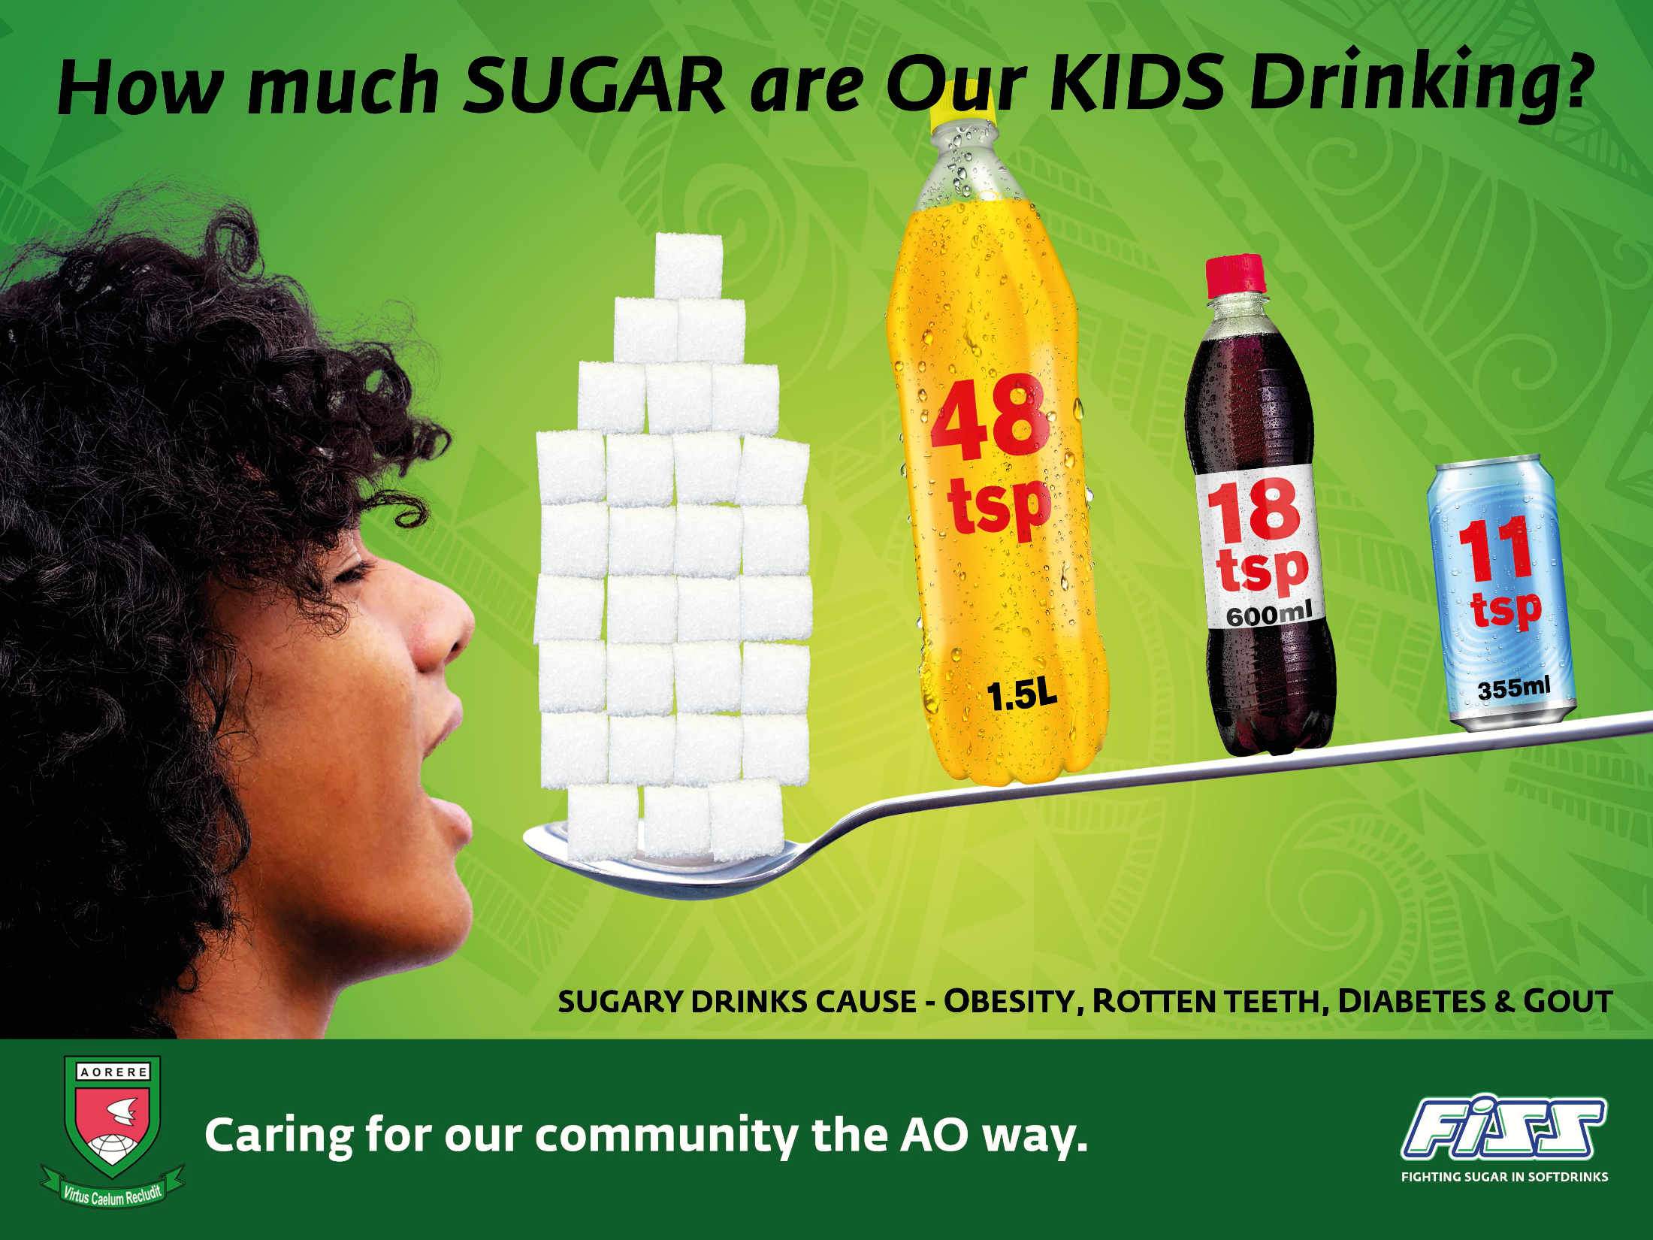

Slide 6
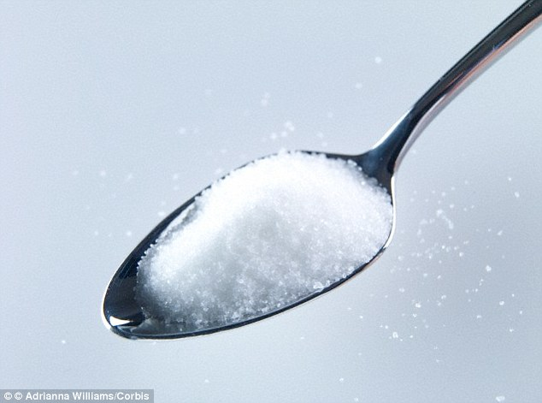
= g
4
A teaspoon of SUGAR
Notes:
There are 4 grams of sugar in 1 teaspoon.
You need to now this to calculate sugar content of products into teaspoons.

Slide 7
How many teaspoons of sugar do you think are in the beverages below?

Slide 8
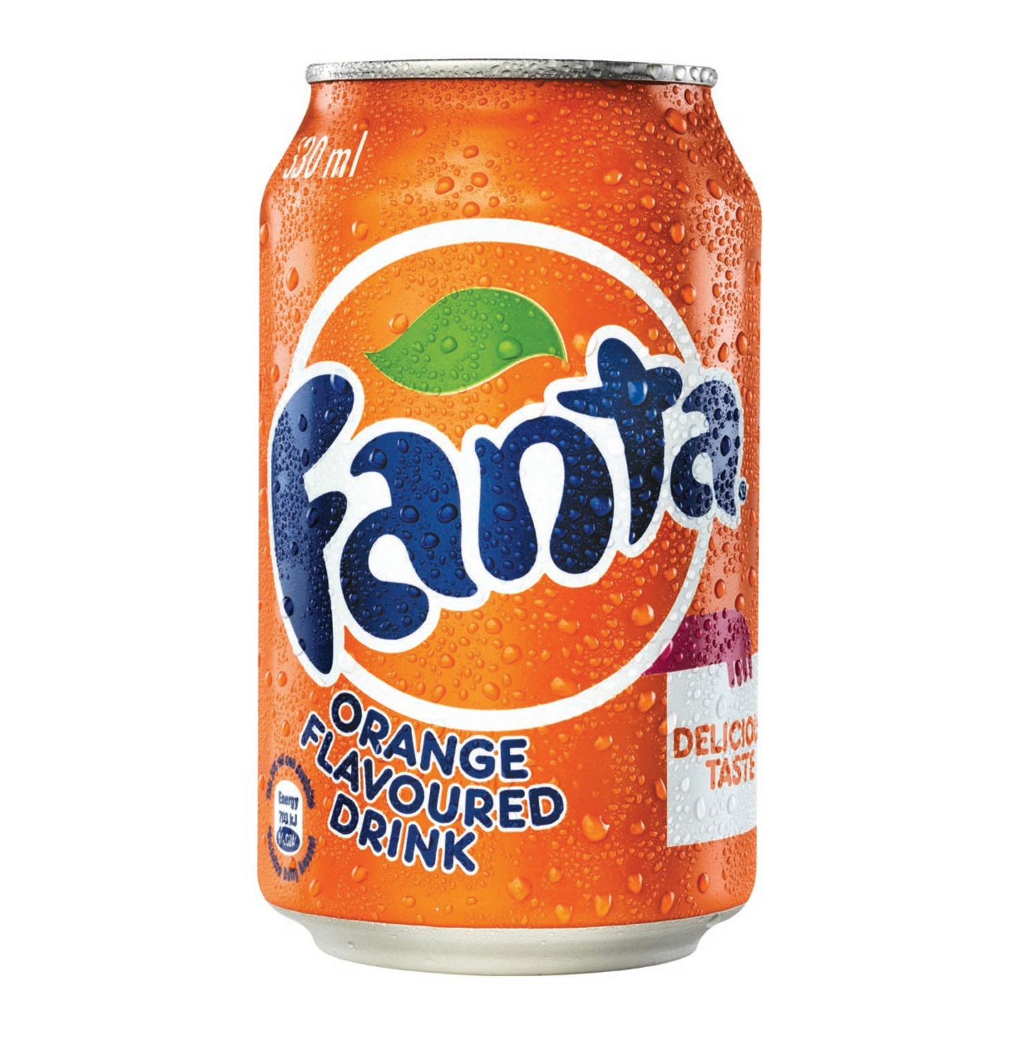
=

Slide 9
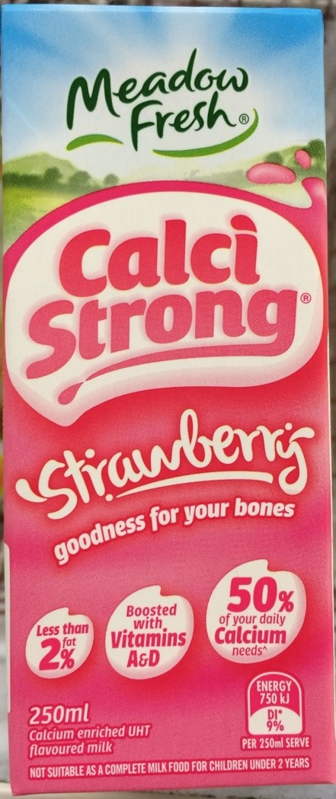
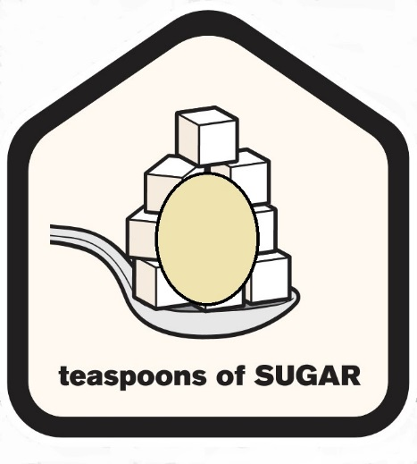
Calci-
Strong
?

Slide 10
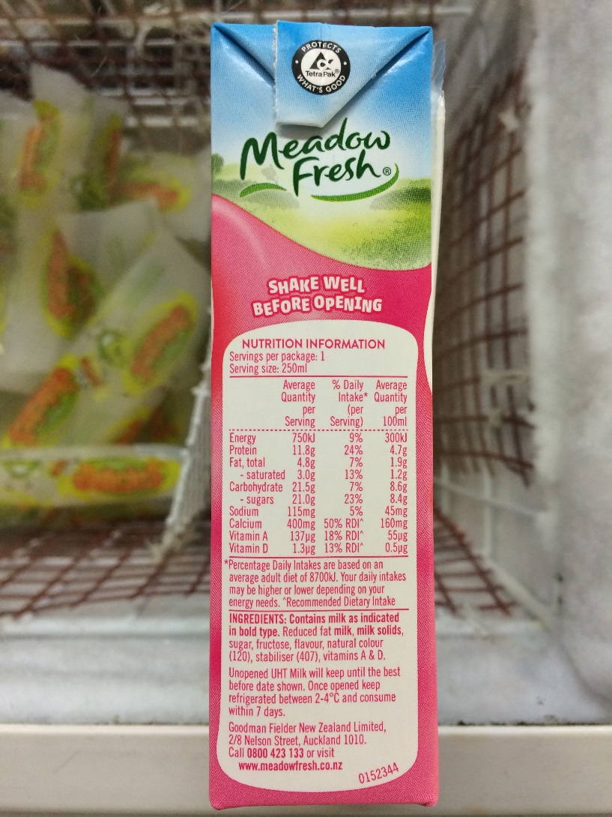
21 ÷ 4 =
≈5 teaspoons

Slide 11
Calci-
Strong
5

Slide 12
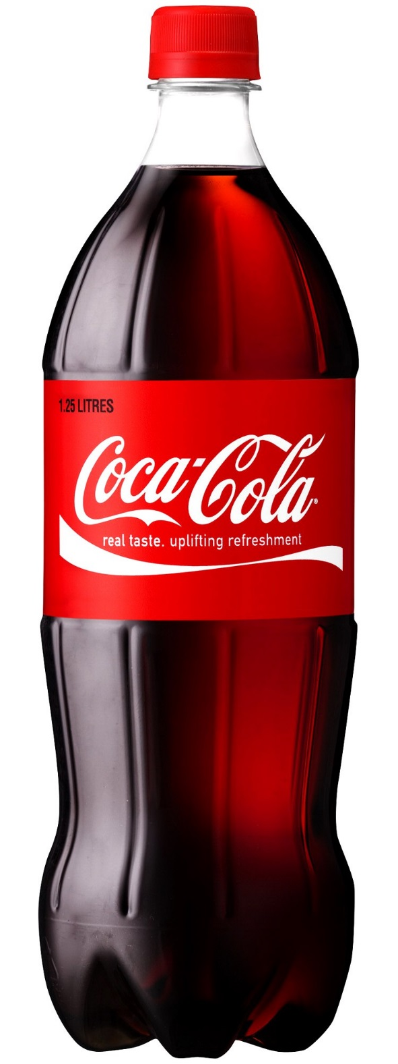
1.5L Coke
?

Slide 13
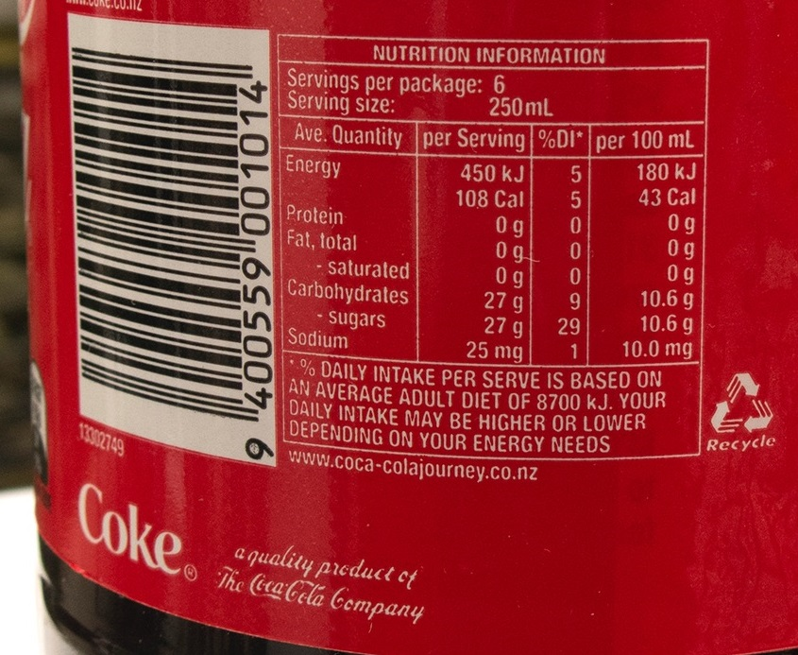
10.6 x 15 =159g
159÷4
≈40 teaspoons

Slide 14
1.5L Coke
40

Slide 15
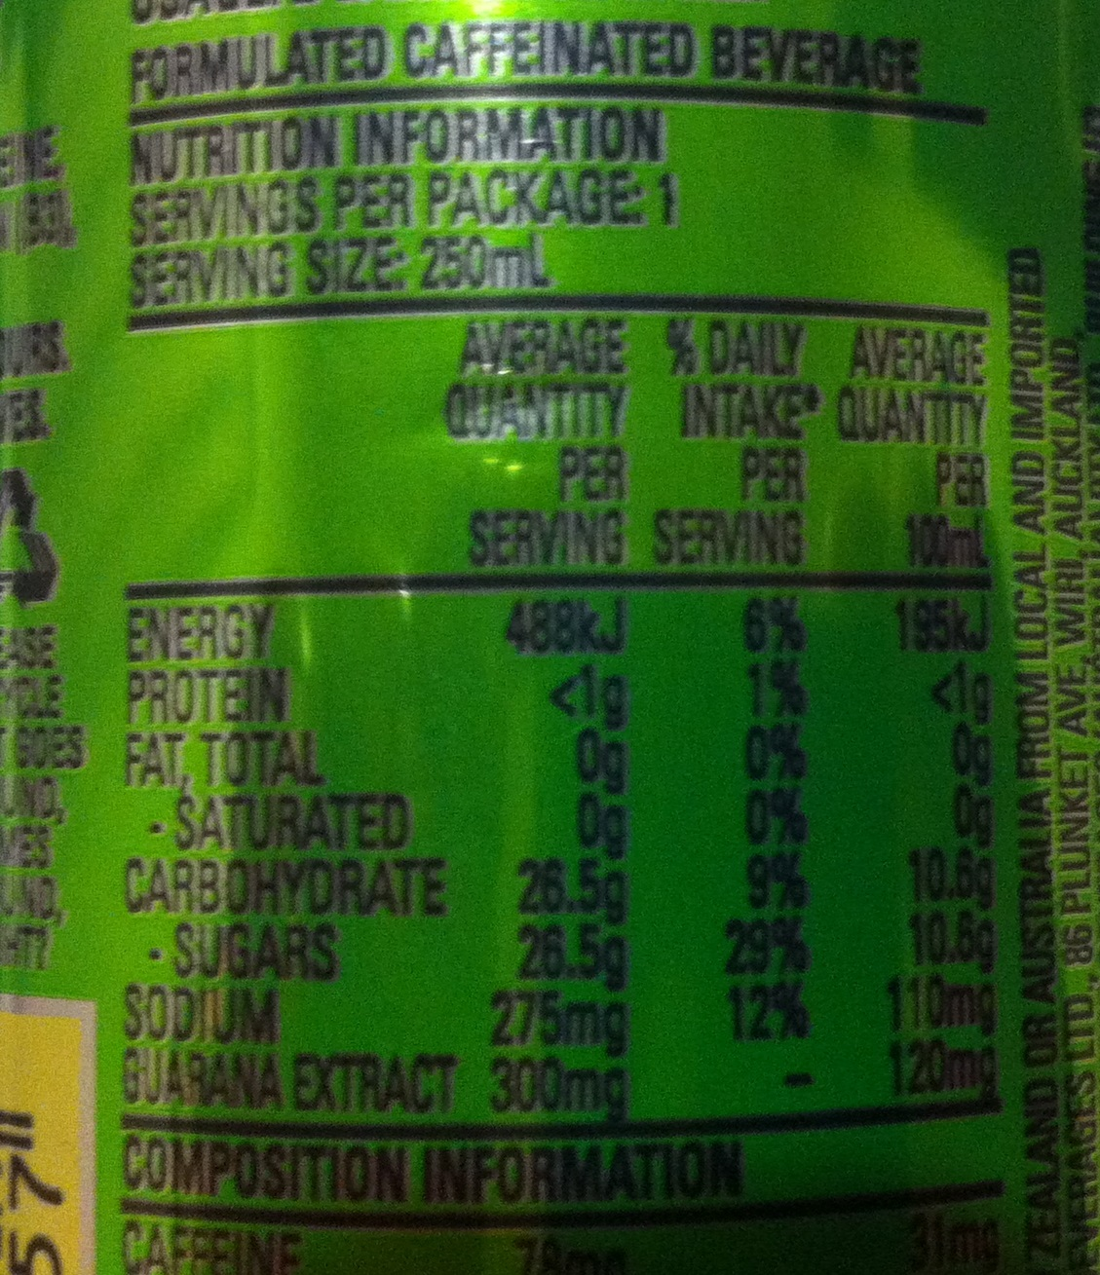
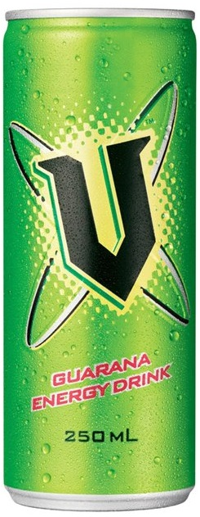
V 250ml
6

Slide 16
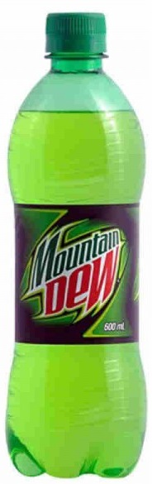
Mountain Dew 600ml
Ave quantity per 100ml
SUGARS 12.4g
18

Slide 17
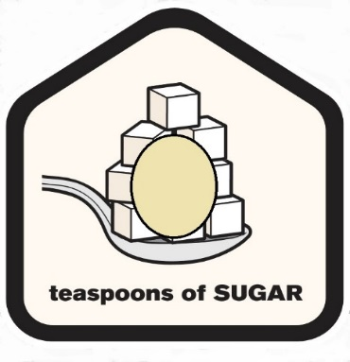
1.5L
6 5 6 11 18 40

Slide 18
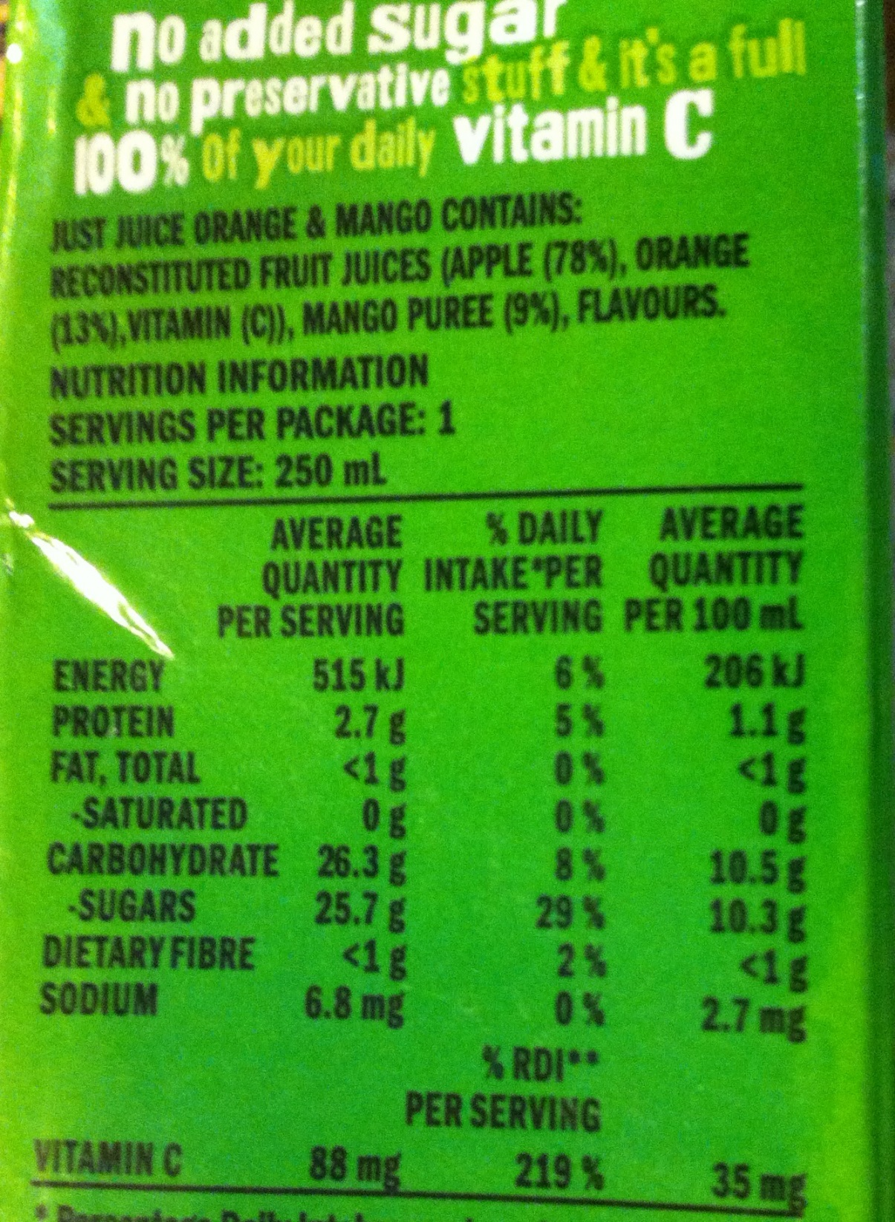
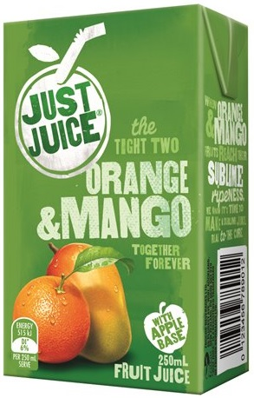
Just Juice 250ml
1 x 26 = 26
26÷ 4 =
6 teaspoons
6

Slide 19

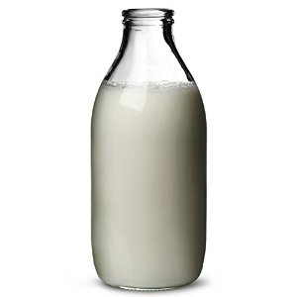
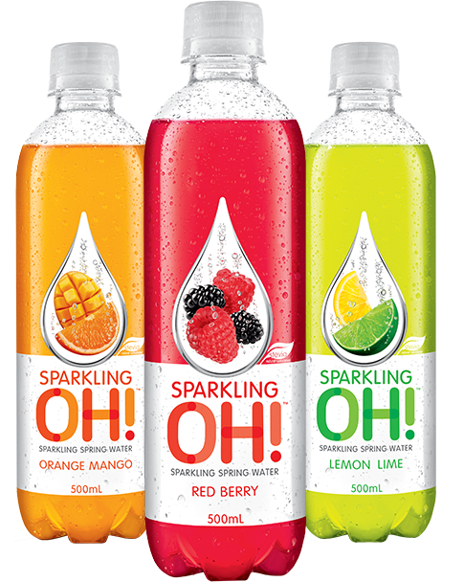
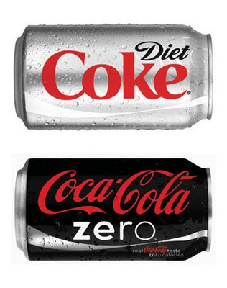
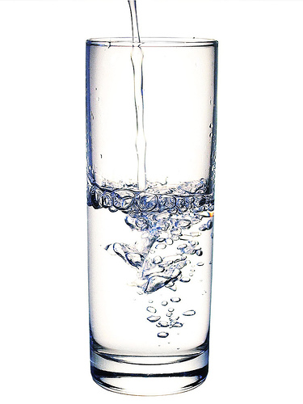
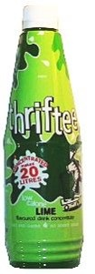
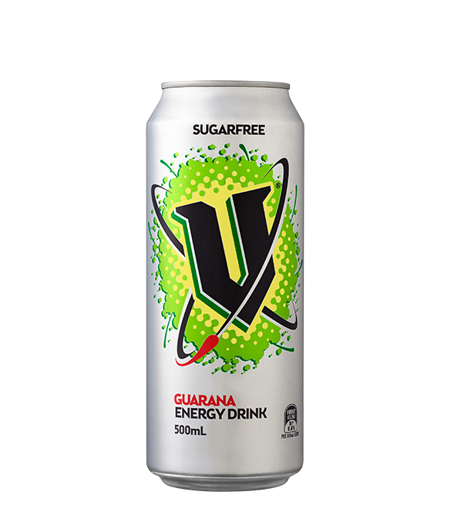
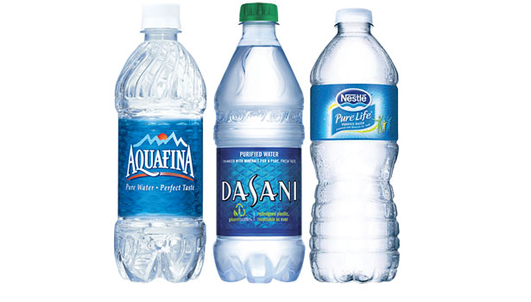
Diet and Zero
Notes:
These drinks have NO sugar and are far better.

Slide 20
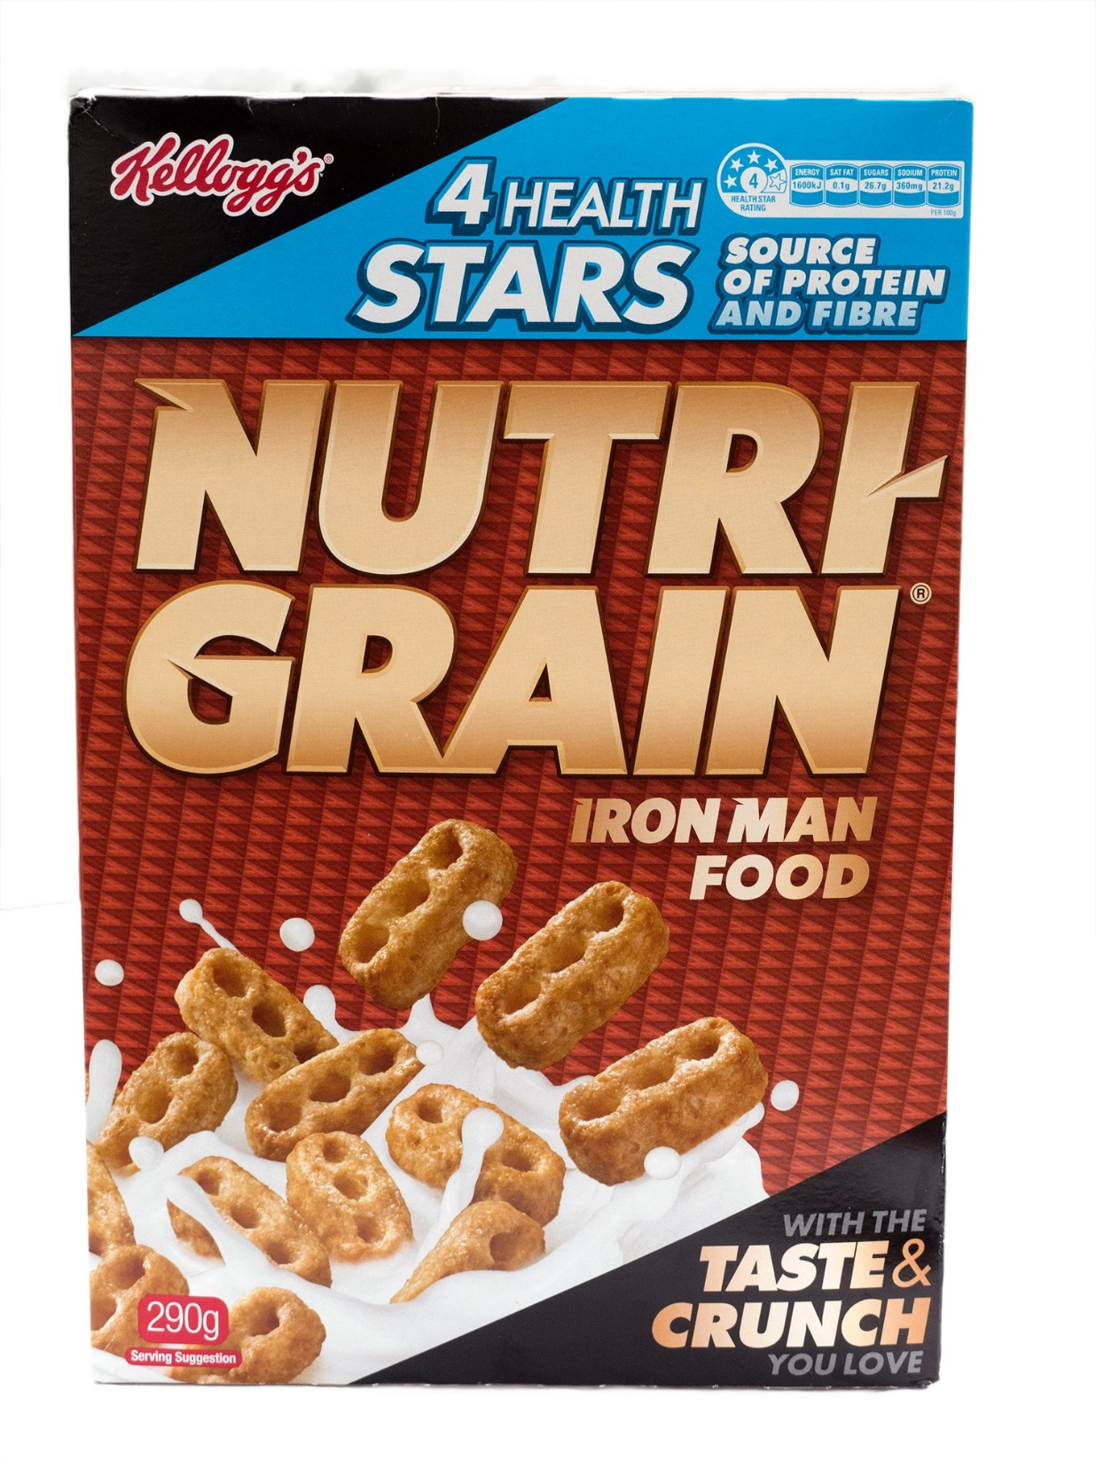
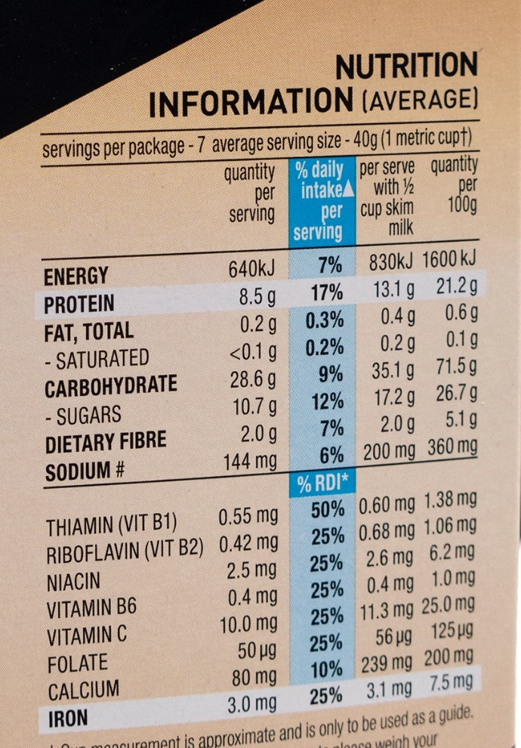
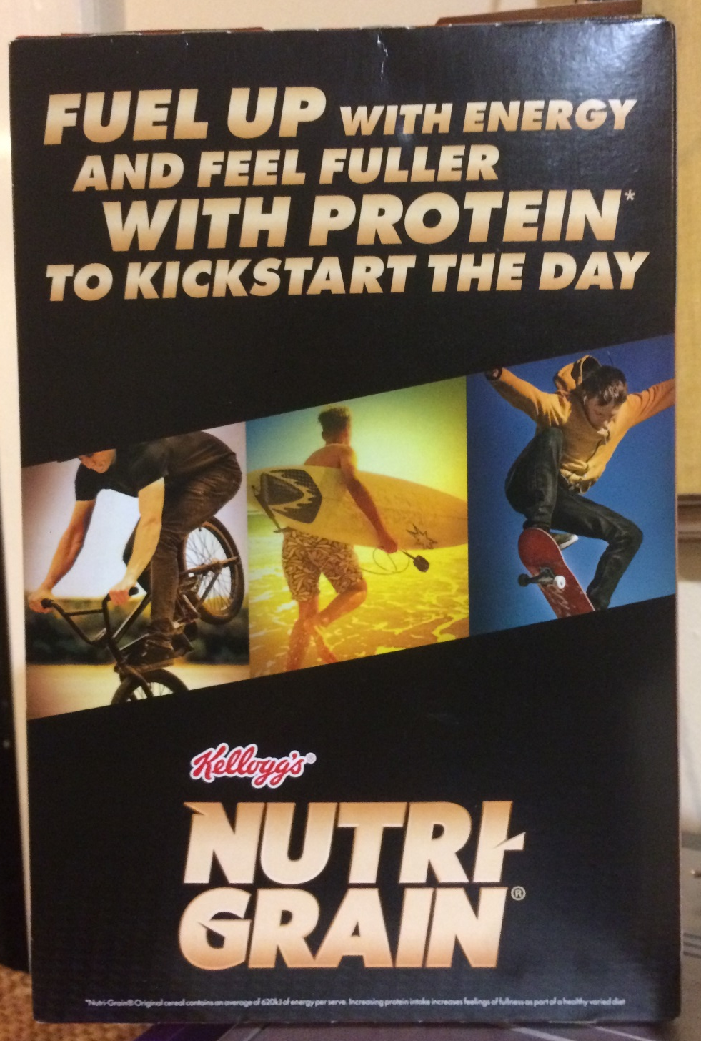
Here there are 5 tricks
27% Sugar,
3 tsp per serve

Slide 21
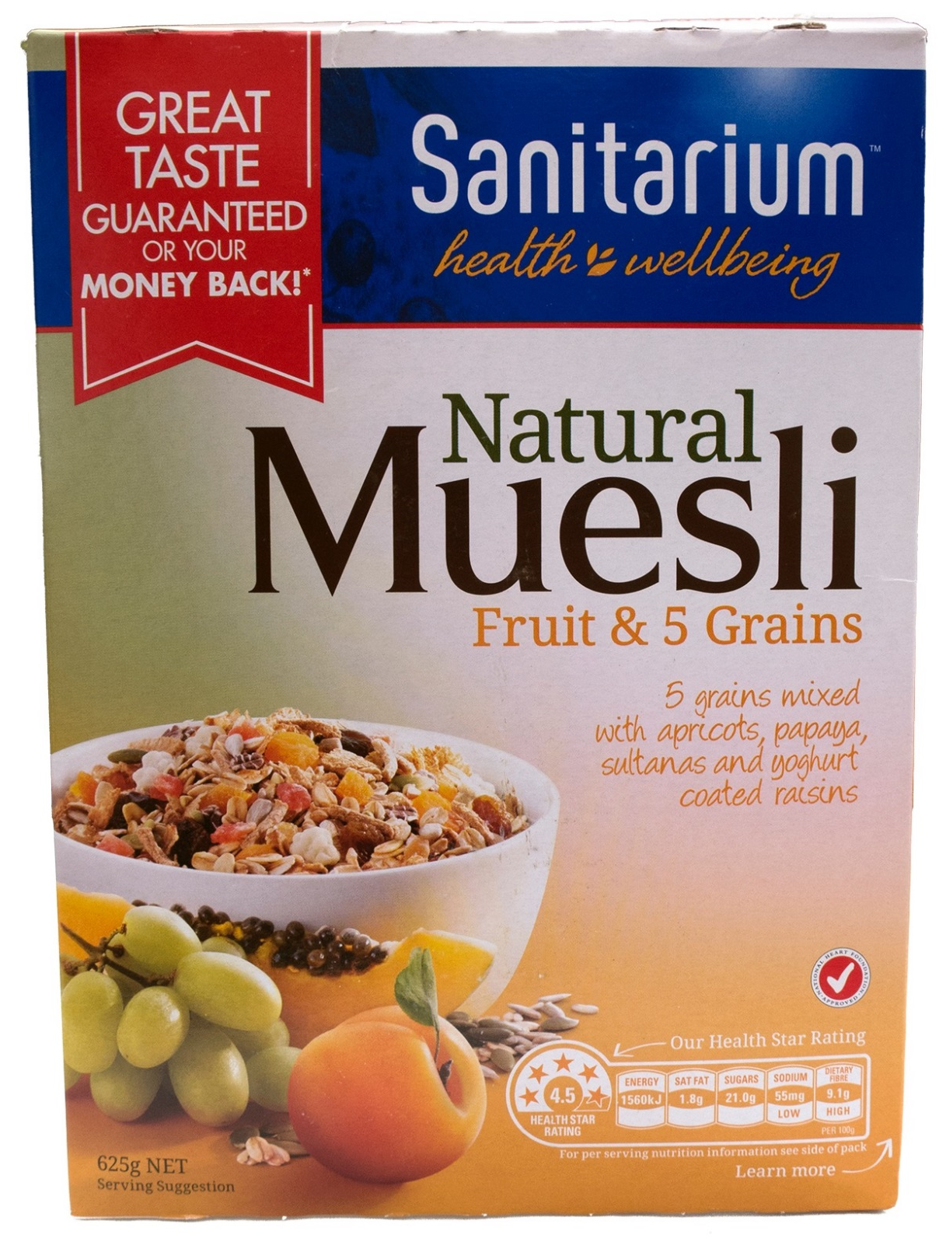
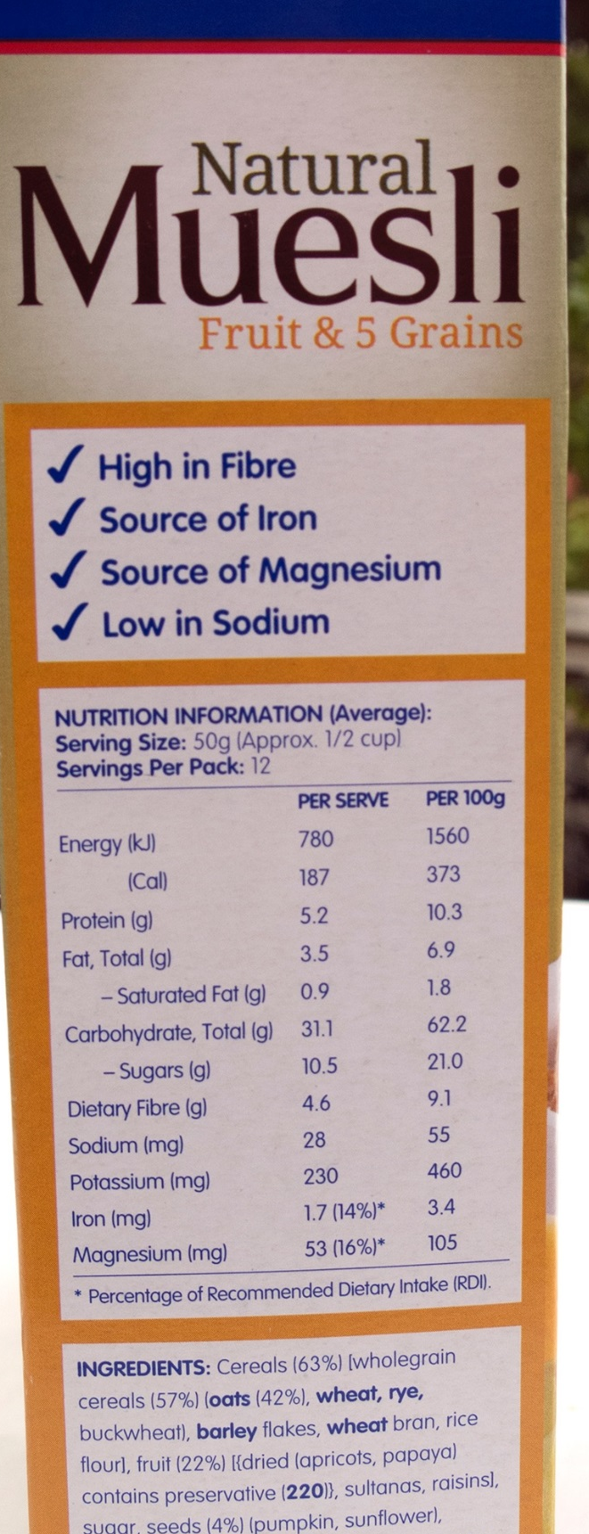
Don’t trust the health claims
Here there are 7 tricks
Most important thing is SUGAR
21% Sugar,
3 tsp per serve

Slide 22



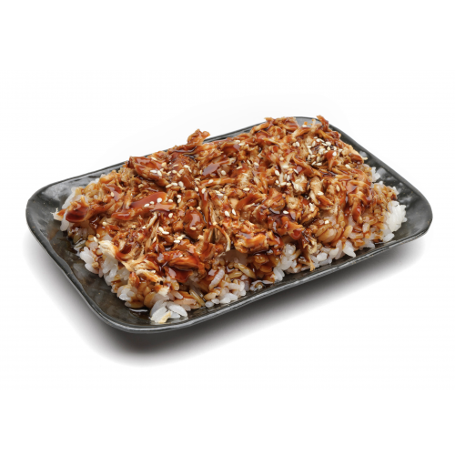
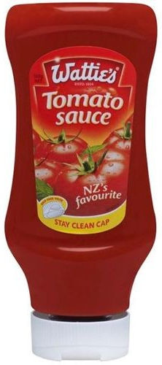
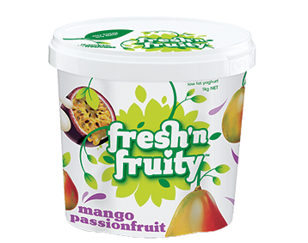
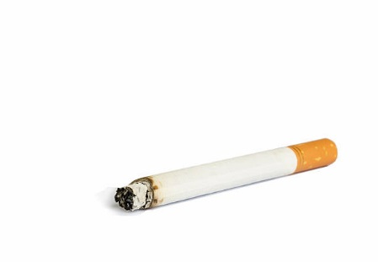
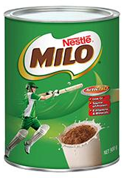
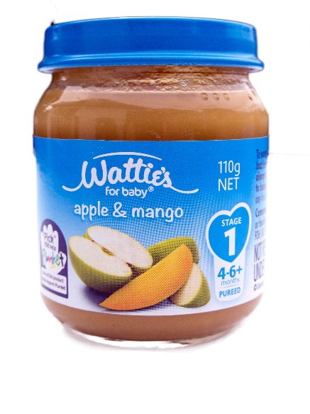
20%
26%
20%
26%
10%
60%
16%
20%

Slide 23
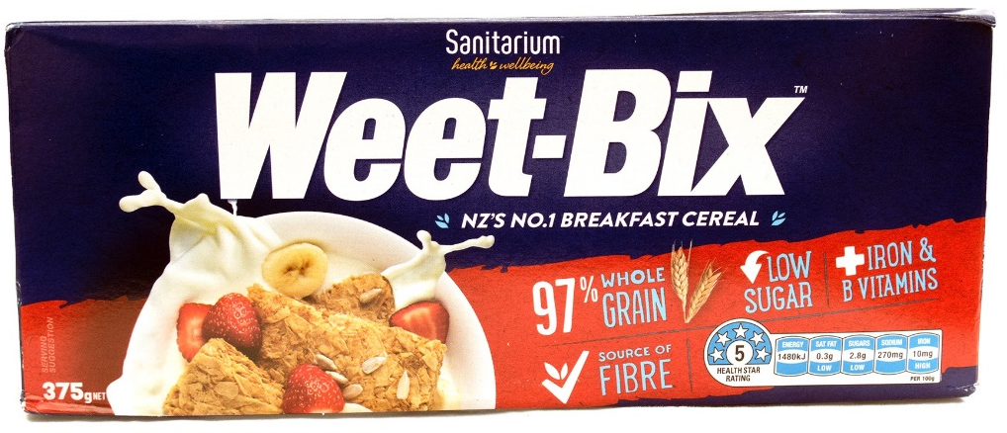
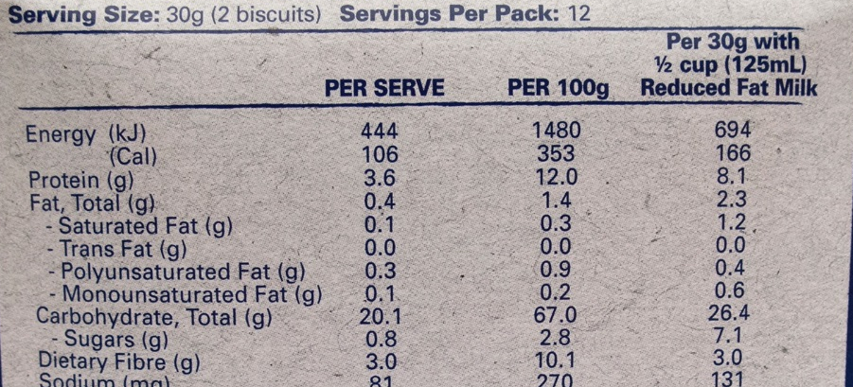
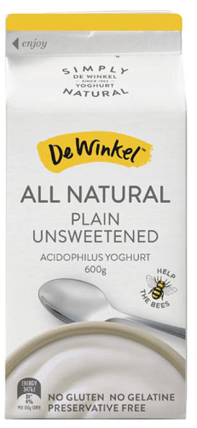
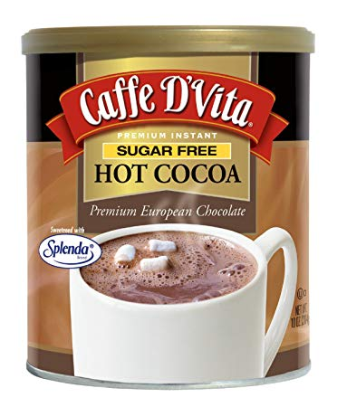
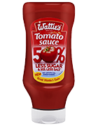
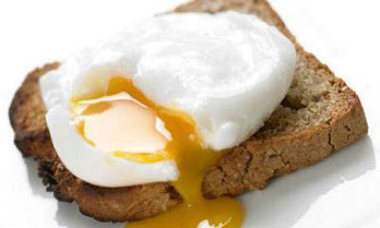
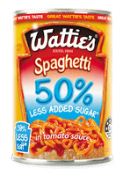
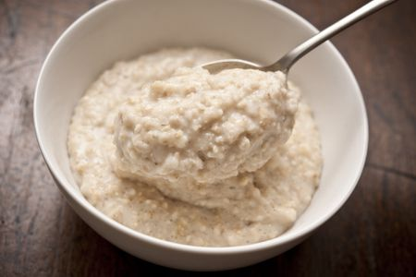
Healthier options -
Cornflakes
Rice Bubbles
Unsweetened
Yogurt
Reduced sugar
options
Porridge

Slide 24
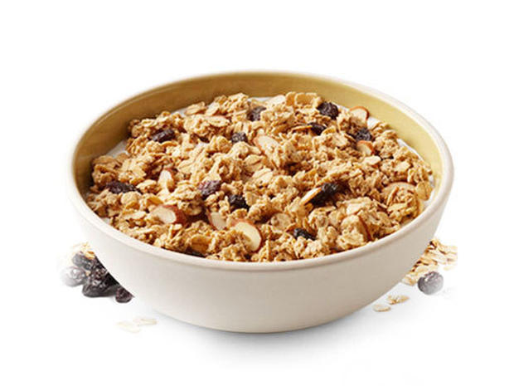
Demo -
What is a typical Serve

Slide 25


Slide 26
RULES: to food choose well?
1. Never TRUST the packaging (industry tricks)
2. Always read the nutrition label – SUGAR content
3. Look for Low or No Sugar options

Slide 27
Test - 1
Get into a team of 4 people
You stay in these Teams for 3 Lessons
Choose a NAME for your team
Write you teams NAME and team members on paper
ANSWER ALL Questions (6 minutes)

Slide 29


